Slide 1
Toxic Comment Classifier
BT4222 Group 5 Final Project
Presenters:
Jeremy Denzel
Vincent Leow
Zhang Yi

Slide 2
AGENDA
01
Context
02
Data Description
03
Data Munging
04
Exploratory Data Analysis
05
Detection Modelling
06
Application
07
Moving Forward & Conclusion

Slide 3
01 Context
Motivation
Background
Workflow

Slide 4

Motivations
1 in 3 encountered cyberbullying
Notes:
https://www.straitstimes.com/singapore/victims-of-cyber-bullying-easily-turn-into-tormentors

Slide 5
Motivations
1 in 2 child suicides due to bullying
Notes:
https://www.straitstimes.com/singapore/victims-of-cyber-bullying-easily-turn-into-tormentors

Slide 6
Background
Using Natural Language Processing and Machine Learning Techniques Taught
01
Gain an understanding of online comments content
02
Develop Machine Learning/ Deep Learning model capable of detecting toxicity
03
Improve online conversations and reduce cyberbullying instances
Notes:
Motivation: Improve online conversation by flagging out negative online behaviors, like toxic comments (i.e. comments that are rude, disrespectful or otherwise likely to make someone leave a discussion)
Solution: Build a multi-headed model that’s capable of detecting different types of of toxicity like threats, obscenity, insults, and identity-based hate.

Slide 7




Workflow
01
02
03
04
05
Data Gathering
Data Preprocessing
Data Preprocessing
Identify Insights
Machine Learning Modelling
App Integration

Slide 8
02 Data Description
Data Summary
Examples

Slide 9
Data Summary
RELEVANCE
KEY FEATURES
Human labeled wikipedia comments
comment_text
toxic
severe_toxic
obscene
threat
insult
identity_hate
SOURCE
Kaggle
FORMAT
.csv
DESCRIPTION
160,000 records and 8 variables (each record represents 1 comment)
LAST UPDATED
2017

Slide 10
Examples
Examples of comments
Hey man, I'm really not trying to edit war. It's just that this guy is constantly removing relevant information and talking to me through edits instead of my talk page. He seems to care more about the formatting than the actual info.
All of my edits are good. Cunts like you who revert good edits because you're too stupid to understand how to write well , and then revert other edits just because you've decided to bear a playground grudge, are the problem. Maybe one day you'll realise the damage you did to a noble project. 201.215.187.159

Slide 11
03 Data Munging
Regex Operation
Stop Words
Vectorization

Slide 12
Regex Operation
BEFORE
AFTER
=)
yay
hahaha
good
good
good
I’m
/n
Wouldn’t
I am
Would not
&
@
1
and
at
one
Notes:
“=)” / “yay” / “hahahaha” good
I’m / Wouldn’t-> I am /Would not
Removed url links and ip addresses
“/n” with empty spaces
& to “and” ,@ to “at” and numbers to its english counterpart.

Slide 13
Stop Words
me
I
he
my
who
am
her
BEFORE
AFTER
“We will go to the cinema after dinner”
“We go cinema dinner”
Notes:
“=)” / “yay” / “hahahaha” good
I’m / Wouldn’t-> I am /Would not
Removed url links and ip addresses
“/n” with empty spaces
& to “and” ,@ to “at” and numbers to its english counterpart.

Slide 14
TF-IDF & CountVectorizer
 | angeles | los | new | post | times | york
d1 | 0 | 0 | 0.584 | 0 | 0.584 | 0.584
d2 | 0 | 0 | 0.584 | 1.584 | 0 | 0.584
d3 | 1.584 | 1.584 | 0 | 0 | 0.584 | 0
“new york times”
“new york post”
“los angeles times”
TF-IDF
 | angeles | los | new | post | times | york
d1 | 0 | 0 | 1 | 0 | 1 | 1
d2 | 0 | 0 | 1 | 1 | 0 | 1
d3 | 1 | 1 | 0 | 0 | 1 | 0
“new york times”
“new york post”
“los angeles times”
CountVectorizer

Slide 15
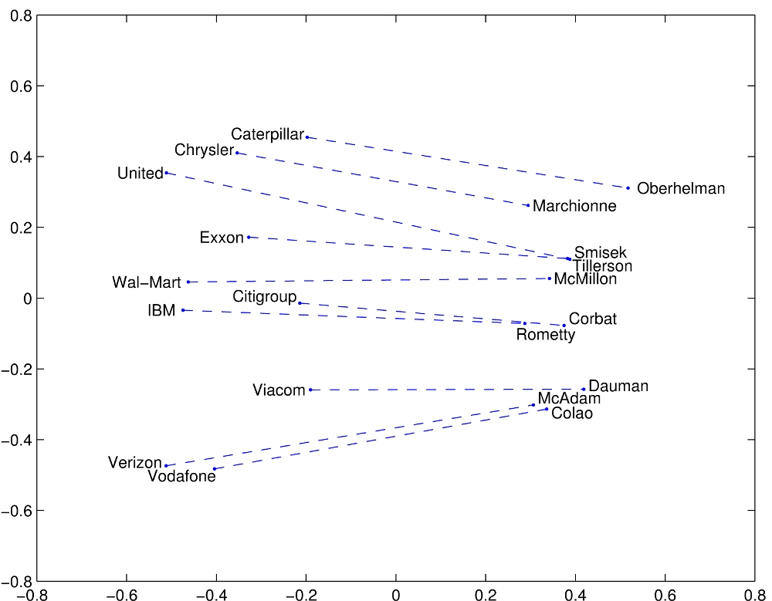
GloVe
GloVe (Global Vectors) creates word embeddings from co-occurrence matrix to derive semantic relationships between words
Pros: Capture frequency and probability of words' co-occurrence in corpus

Slide 16
04 Exploratory Data Analysis
Syntactic
Analysis
Semantic
Analysis
Sentiment
Analysis
Statistical
Analysis

Slide 17
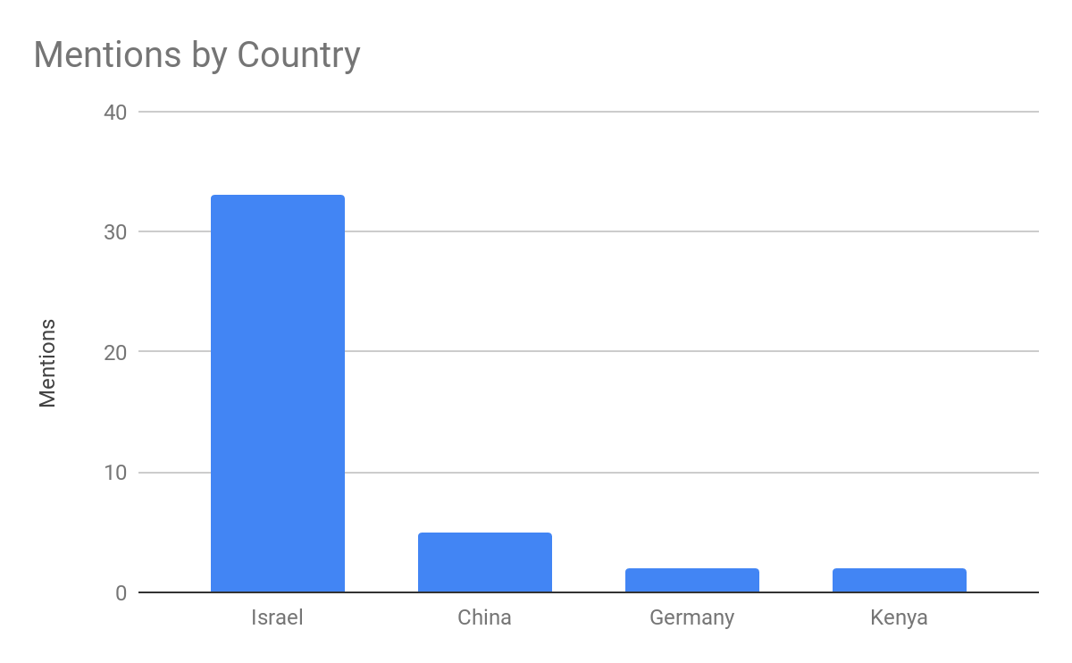
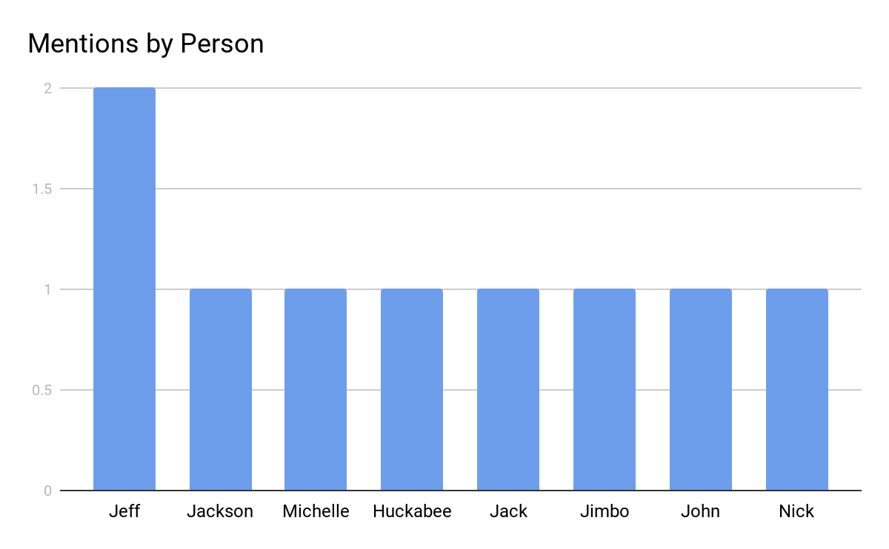
Syntactic Analysis
NER
Notes:
“=)” / “yay” / “hahahaha” good
I’m / Wouldn’t-> I am /Would not
Removed url links and ip addresses
“/n” with empty spaces
& to “and” ,@ to “at” and numbers to its english counterpart.

Slide 18
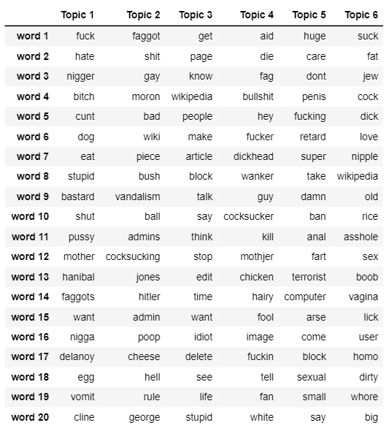
Semantic Analysis - Topic Modelling
1
POS Tagging (Noun, Verb, Adjective)
2
Filter Extremes, Generate Dictionary
and Corpus
3
Model Topics using LDA and
Coherence Value
Notes:
“=)” / “yay” / “hahahaha” good
I’m / Wouldn’t-> I am /Would not
Removed url links and ip addresses
“/n” with empty spaces
& to “and” ,@ to “at” and numbers to its english counterpart.

Slide 19
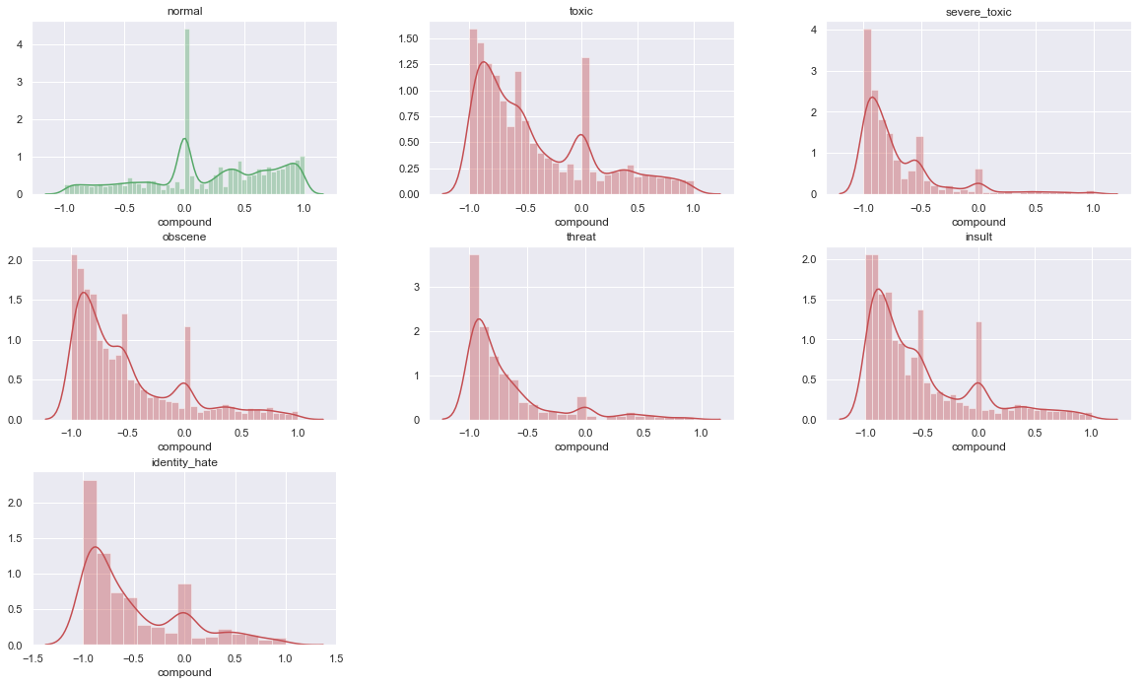
Sentiment Analysis
Vader: SentimentIntensityAnalyzer
Calculate sentiment score text in all categories
Plot Distribution Score of Score
All toxic comments are right skew-high distribution of negative score
Notes:
“=)” / “yay” / “hahahaha” good
I’m / Wouldn’t-> I am /Would not
Removed url links and ip addresses
“/n” with empty spaces
& to “and” ,@ to “at” and numbers to its english counterpart.

Slide 20
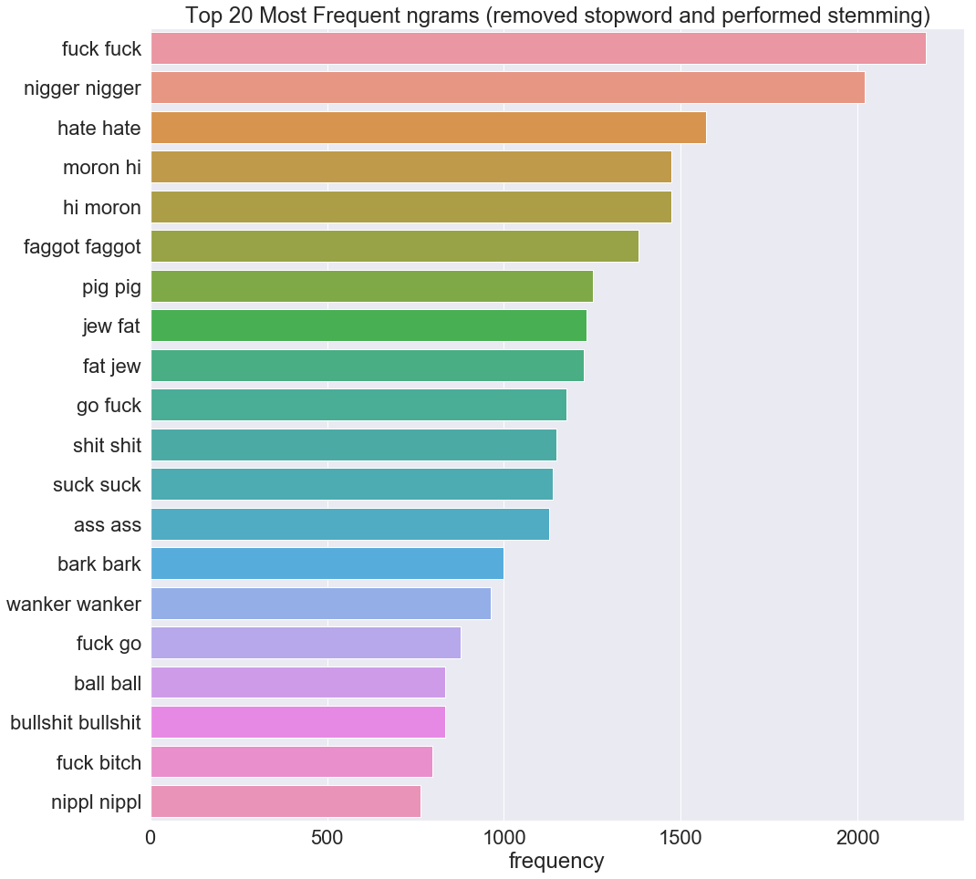
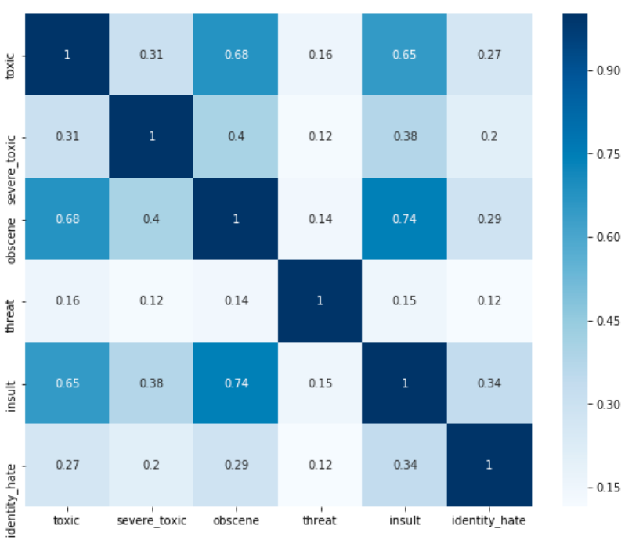
Statistical Analysis
Top Ngram Frequency
Correlation Analysis
Notes:
“=)” / “yay” / “hahahaha” good
I’m / Wouldn’t-> I am /Would not
Removed url links and ip addresses
“/n” with empty spaces
& to “and” ,@ to “at” and numbers to its english counterpart.

Slide 21
05 Detection Modelling
Machine Learning
Deep Learning

Slide 22
Machine Learning WorkFlow
Stacking
Base Classifiers
RandomForest
Logistic Regression
Naive Bayes
SVM
SGDClassifier
XGB
LGB
TF-IDF
Classifier 1
L2
Classifier
Classifier 2
CountVectorizer + SVD
Optimization
Classifier 3
GloVe
Classifier 4
Google’s Word2Vec
Results

Slide 23
Stacking
Base Classifiers
RandomForest
Logistic Regression
Naive Bayes
SVM
SGDClassifier
XGB
LGB
TF-IDF
Classifier 1
L2
Classifier
Classifier 2
CountVectorizer + SVD
Optimization
Classifier 3
GloVe
Classifier 4
Google’s Word2Vec
Result

Slide 24
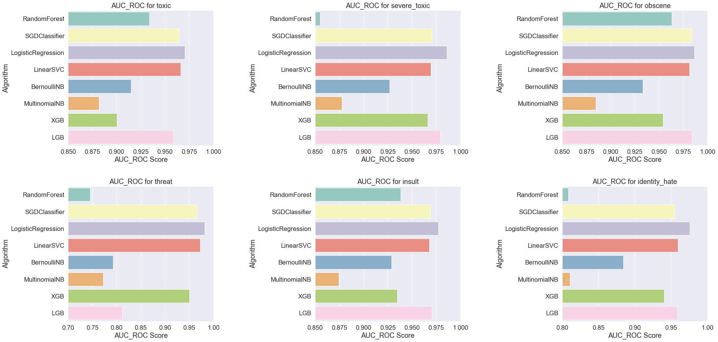
Machine Learning - TF- IDF

Slide 25
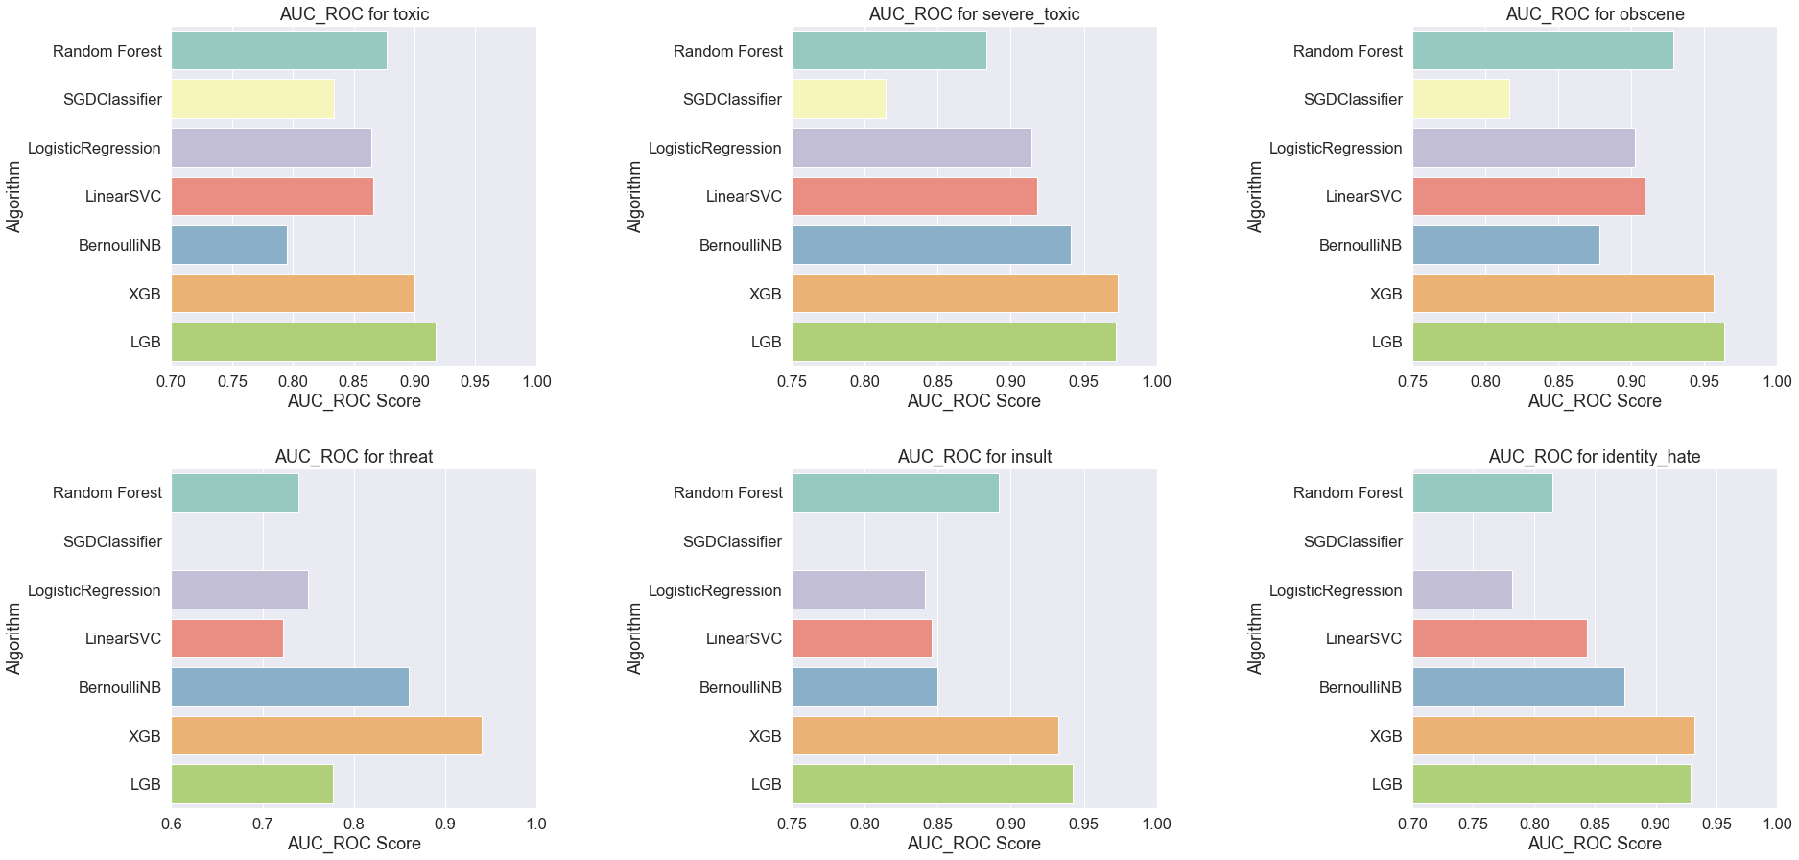
Machine Learning - CountVectorizer

Slide 26
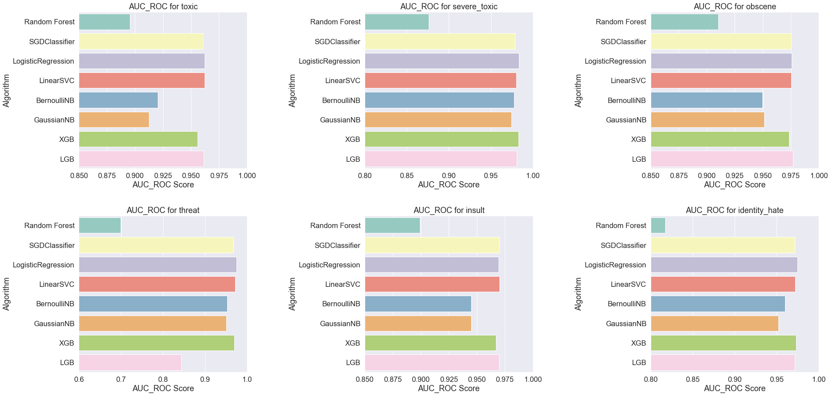
Machine Learning - GloVe

Slide 27
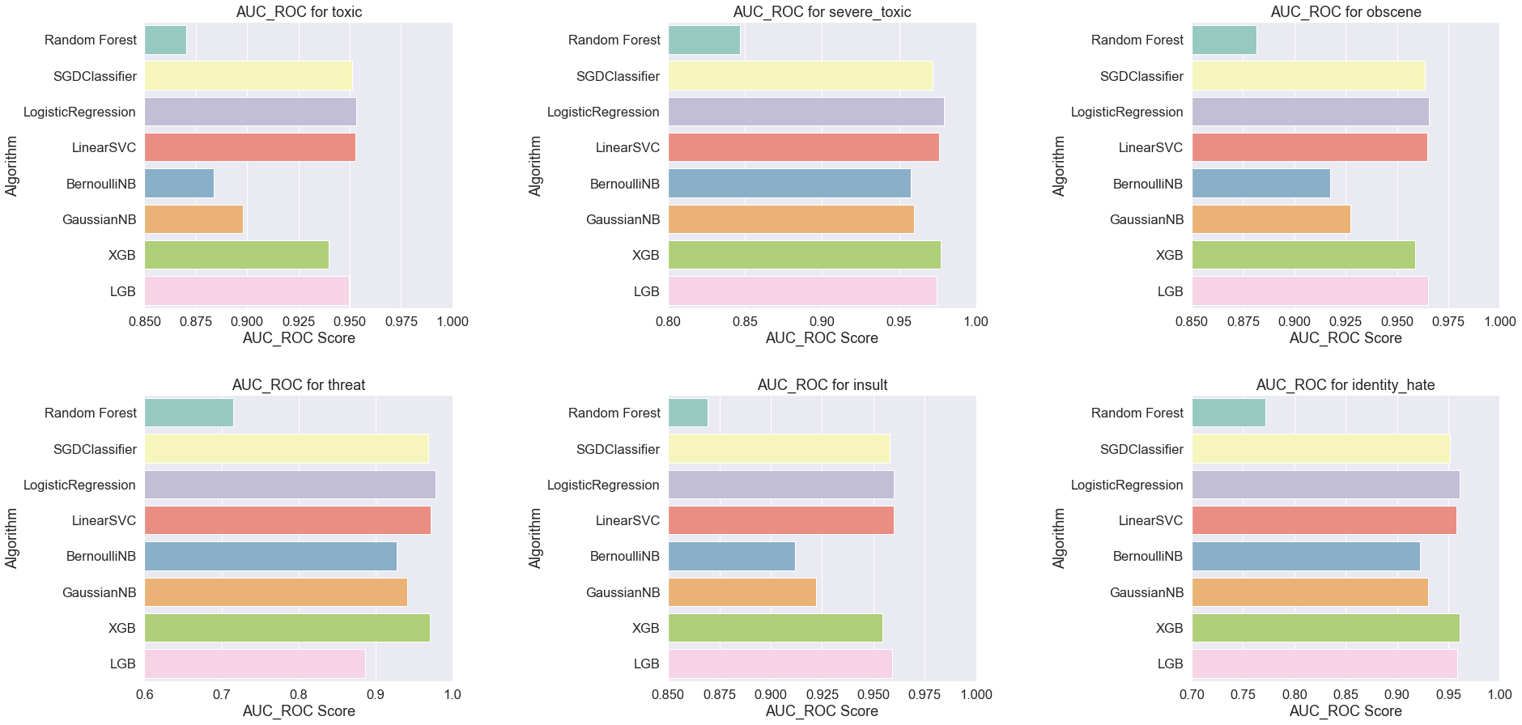
Machine Learning - Word2Vec (Google)

Slide 28
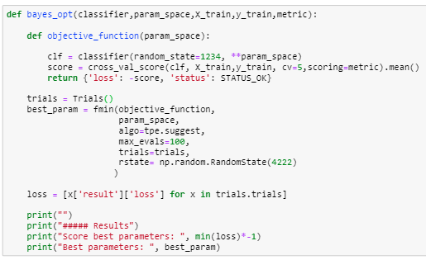
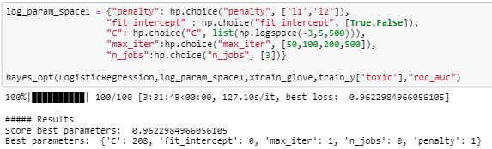
Bayesian Optimization
Focus on finding the minimum/maximum of an objective function.
Require fewer iterations to find the most optimal set of parameter as compared to GridSearch and RandomSearch
Equally effective

Slide 29
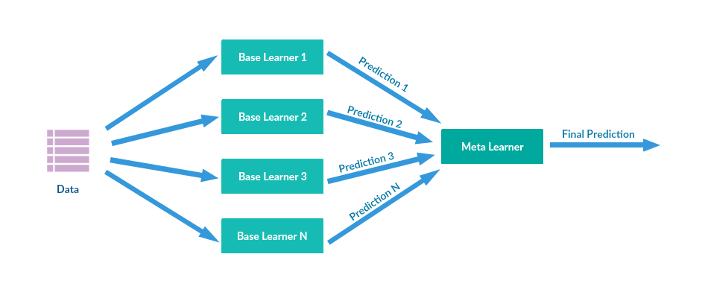
Stacking (In-Progress)
Stacking is an ensemble learning technique that combines multiple classification or regression models via a meta-classifier or a meta-regressor. The base level models are trained based on a complete training set, then the meta-model is trained on the outputs of the base level model as features

Slide 30
Deep Learning WorkFlow
Stacking
Convolutional Neural Network (CNN)
L2
Classifier
CountVectorizer
Bidirectional Long Short-term Memory (BiLSTM)
Classifier 1
Optimization
GloVe
Classifier 2
Long Short-term Memory (LSTM)
Results

Slide 31
Deep Learning-LSTM
LSTM Model
Capture sequential features that are temporal and past behaviours
Sequential text features represent grammar and meaning
Useful in knowing context of toxic comments
Input matrix
Embedding matrix
Embedding
LSTM Model
Bidirectional LSTM
Max pooling layer
Max Pooling
Dense layer
50 nodes
Output
Notes:
And this is the architedure of the LSTM model
Embedding layer to compress the input feature space into a smaller one.
Bidirectional LSTMs train two LSTMs , input sequence and reversed copy on the input sequence, provide additional context to the network, faster and fuller learning on the problem
Max Pooling get maximum value for each patch of the feature map, and highlight the most present feature. Useful for summarising feature presence.
Dropout - prevent model from overfitting

Slide 32
Deep Learning-CNN
CNN Model
Input matrix
Embedding
Capture spatial patterns in texts
Expressions of words, similar to ngrams
Useful in detecting toxic phrases and expressions used
Spatial Dropout 1D
Bidirectional GRU
Conv1D
Max Pooling
Average Pooling
Output
Notes:
-> Spatial Dropout differs from Dropout in that they remove entire row of pixels instead of just one. Reduces overfitting even more as it removes adjacent pixels that are correlated as well for images.
Convolutional layers prove very effective close to the input to learn low-level features (e.g. lines) and layers deeper in the model to learn high-order or more abstract features, like shapes or specific objects.
Batch normalisation adjust and scale the activations to speed up learning.
-> Parametric Rectified Linear Unit generalize the traditional rectified unit (PReLU) same accuracy as ReLU but increase the learning speed by not deactivating some neurons

Slide 33
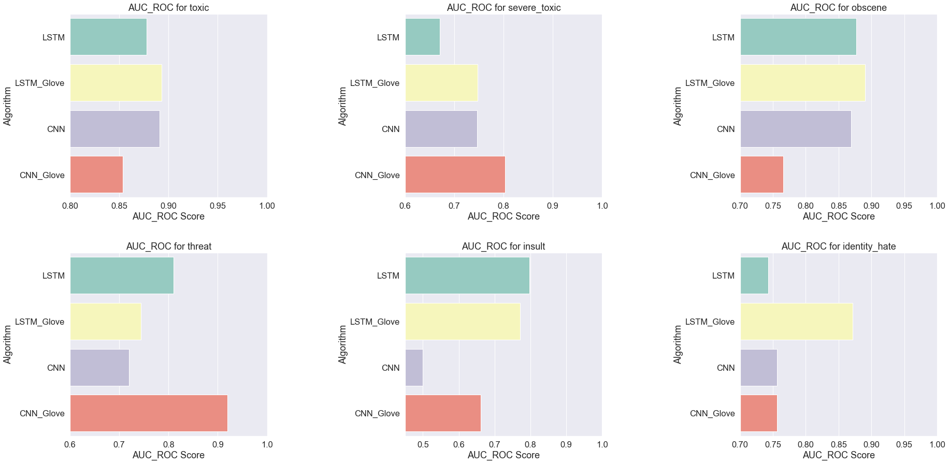
Deep Learning - Results

Slide 34
06 Application
Infrastructure
Demo

Slide 35




Infrastructure
Server
Telegram
Users
Listening Port
Send Message
Post Response
Receive Message
Bot API
Receive
Results
Feed Text
Machine Learning Model
Notes:
After building our machine learning models, we will integrate it into a telegram that will censor out toxic comments

Slide 36
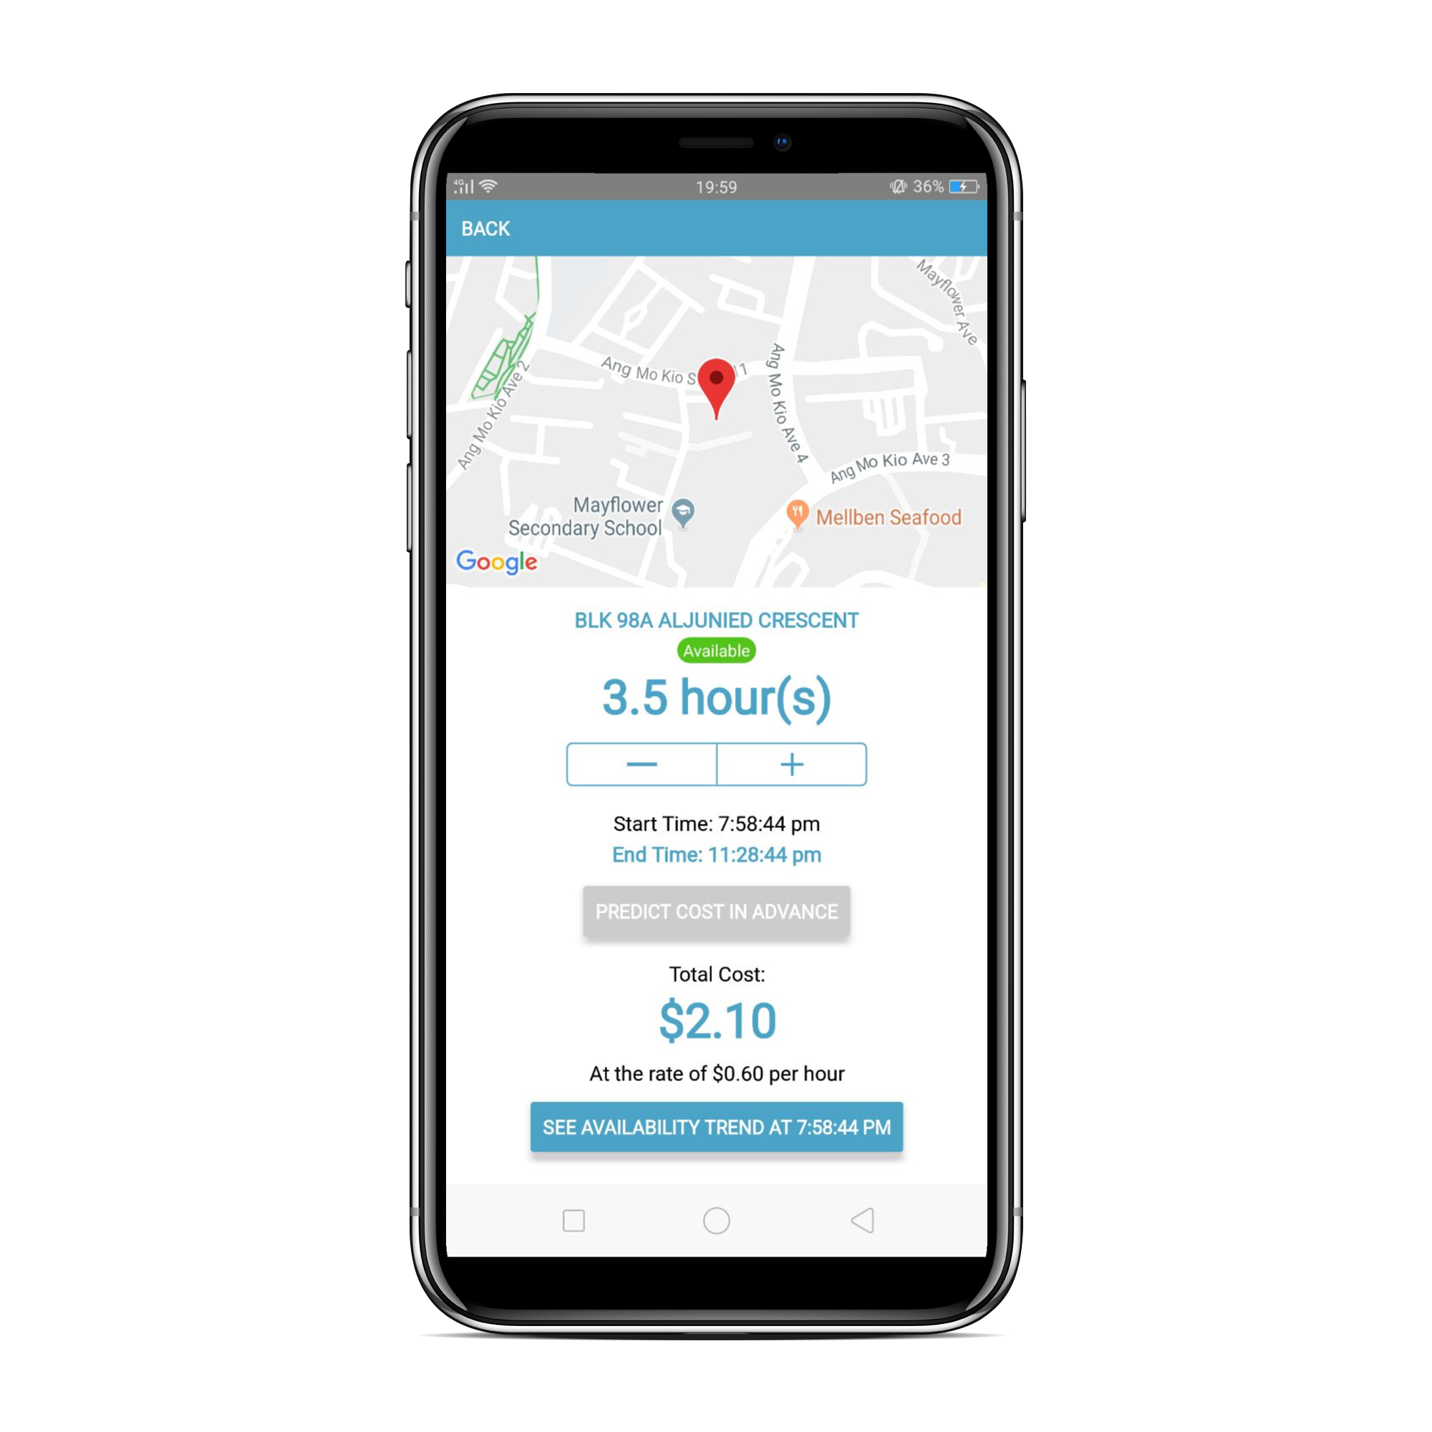

Demo

Slide 37
Moving Forward
Apply Detection Model onto other platforms eg Class Forums, Reddit
Apply technique to detect online Radicalization/Combat Terrorism
Implement NER on bot to take note of users who are frequently bullied

Slide 38
Thank you!
Notes:
And that's the end of our presentation

